Slide 1
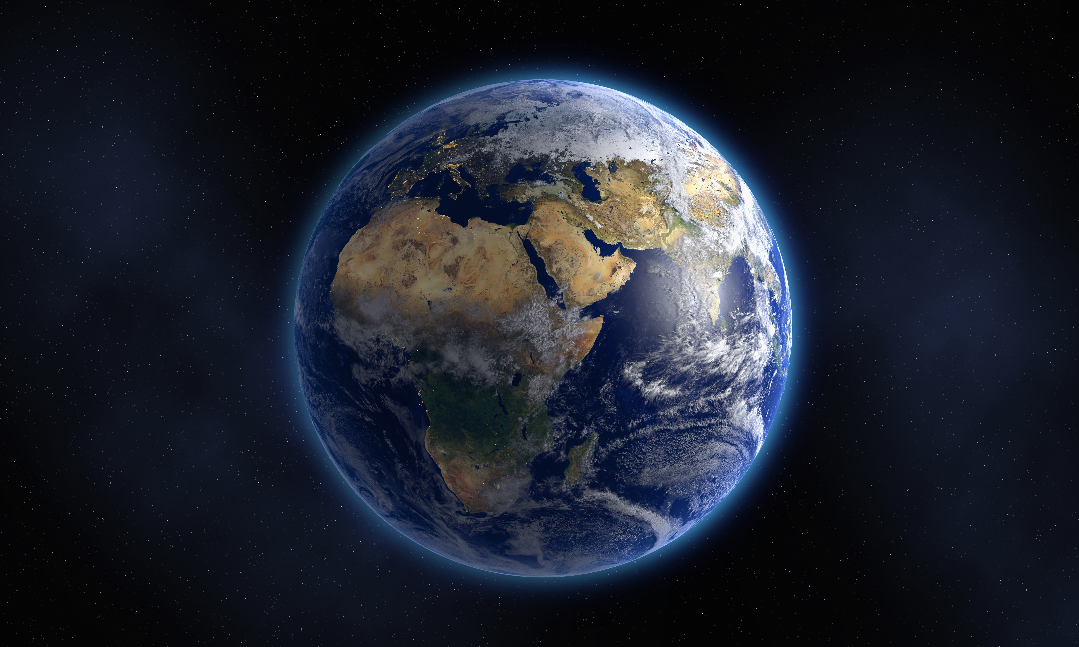
AERIAL IMAGE MISMATCH
By Anirban Sarkar
https://github.com/AnirbanML/Satellite_Image_Mismatch.git

Slide 2
Business Problem
Need a low cost terrain monitoring and infrastructure assessment technique that can identify types of object found in an satellite image.
The main idea would be to identify objects present in satellite image and give a comparative mismatch of objects found in the images.
The dataset contains labelled 10 different classes:
Buildings - large building, residential, non-residential, fuel storage facility, fortified building
Misc. Manmade structures
Road
Track - poor/dirt/cart track, footpath/trail
Trees - woodland, hedgerows, groups of trees, standalone trees
Crops - contour ploughing/cropland, grain (wheat) crops, row (potatoes, turnips) crops
Waterway
Standing water

Slide 3
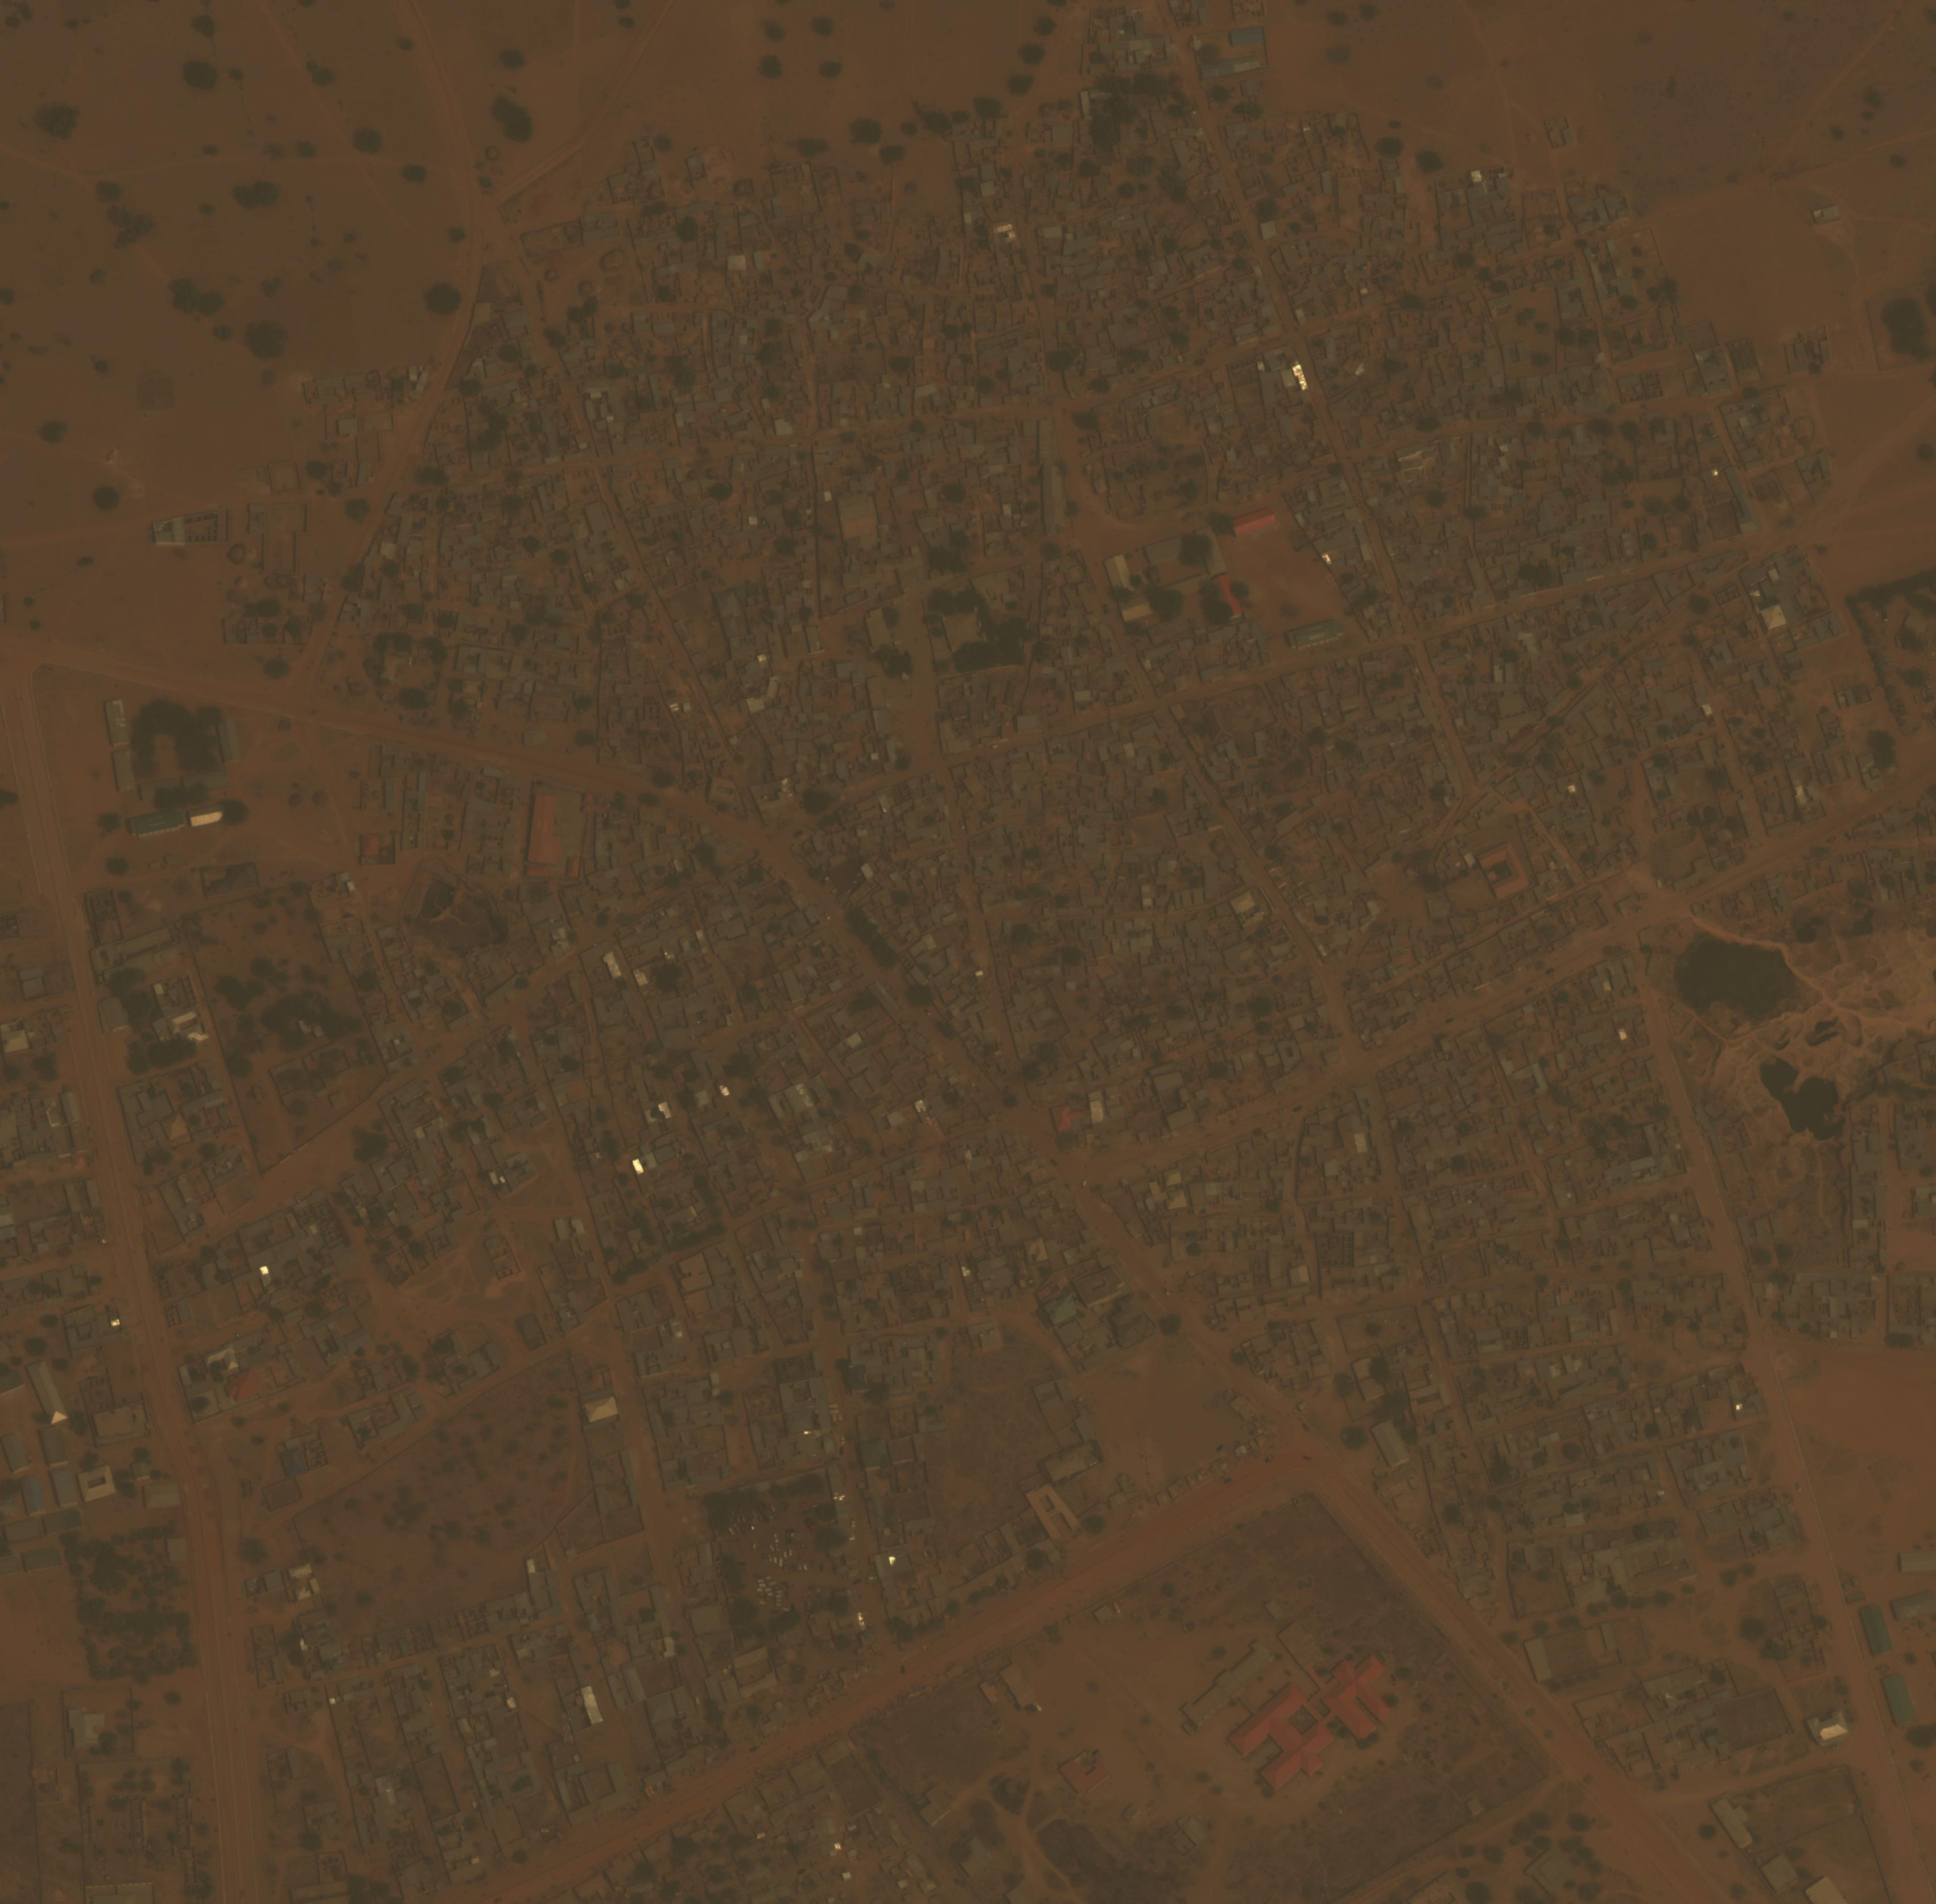
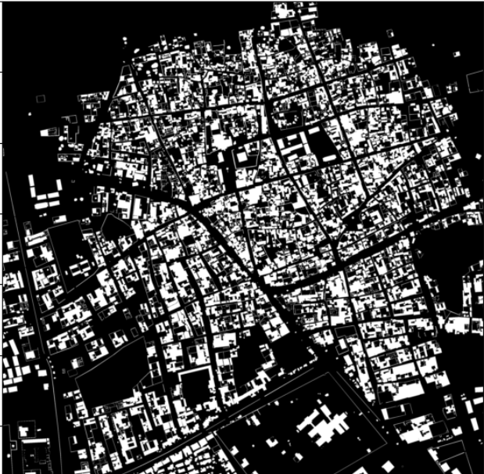
Data Pre-processing (mapping ground truth)
Original Image
Ground truth
(Buildings and manmade structures)

Slide 4
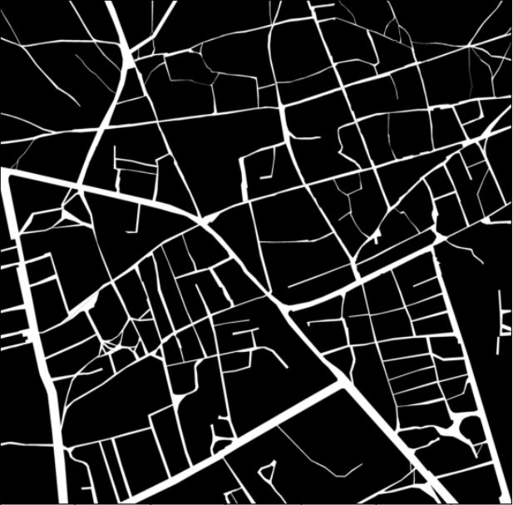
Data Pre-processing (mapping ground truth)
Original Image
Ground truth
(Roads and dirt track)

Slide 5
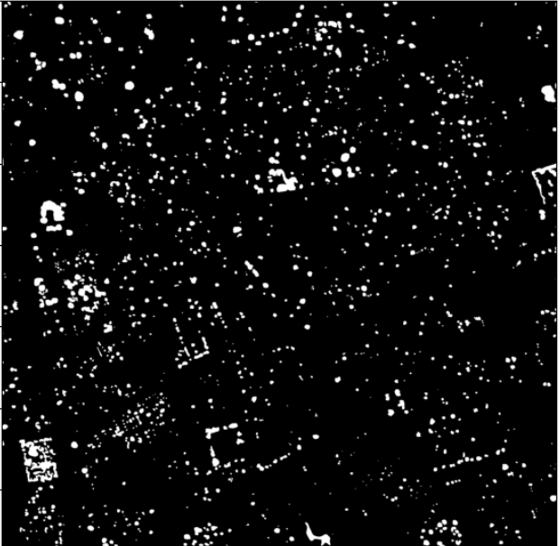
Data Pre-processing (mapping ground truth)
Original Image
Ground truth
(trees)

Slide 6
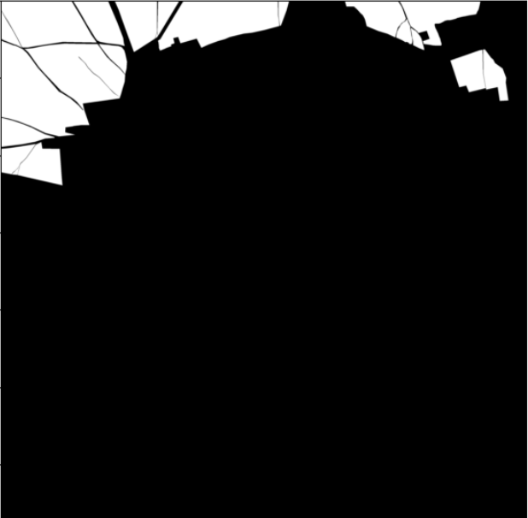
Data Pre-processing (mapping ground truth)
Original Image
Ground truth
(CROPS)

Slide 7
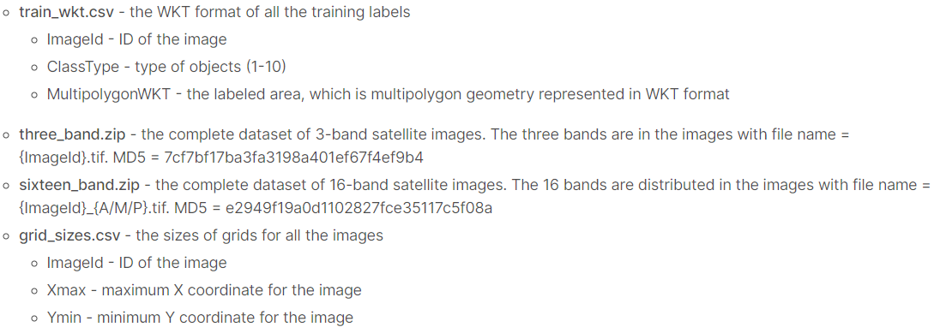
Dataset info

Slide 8

Unet architecture
8
16
64
128
256

Slide 9
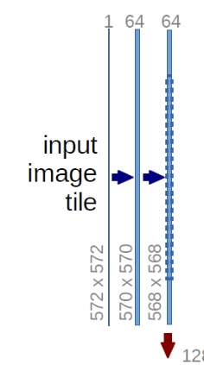
Unet With InCeption
Max pool
16 – 32 – 64 – 128 – 256 – 128 – 64 – 32 – 16

Slide 10
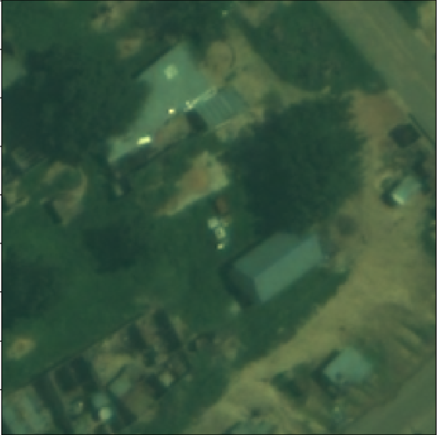
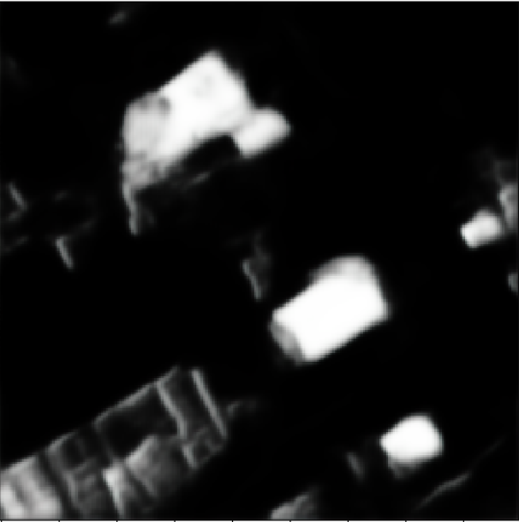

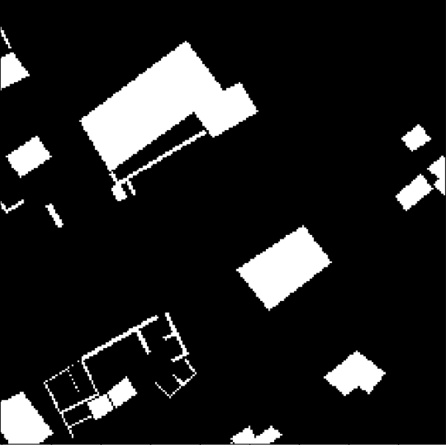
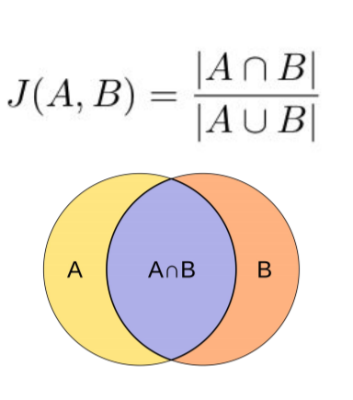
baseline
Optimizer: Adam
Loss : binary_crossentropy
Mid_activation_fn : Relu
O/P_activation_fn : Sigmoid
Metrics: Jaccard similarity
X
Predicted
RGB (224X224X3)
Y
(224X224X3)
MASK (224X224X3)

Slide 11
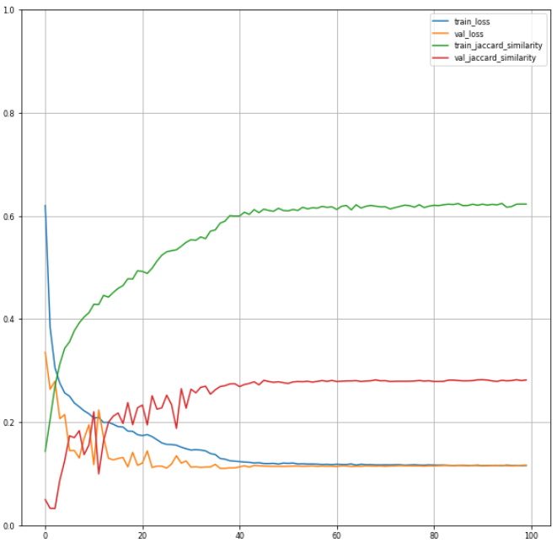
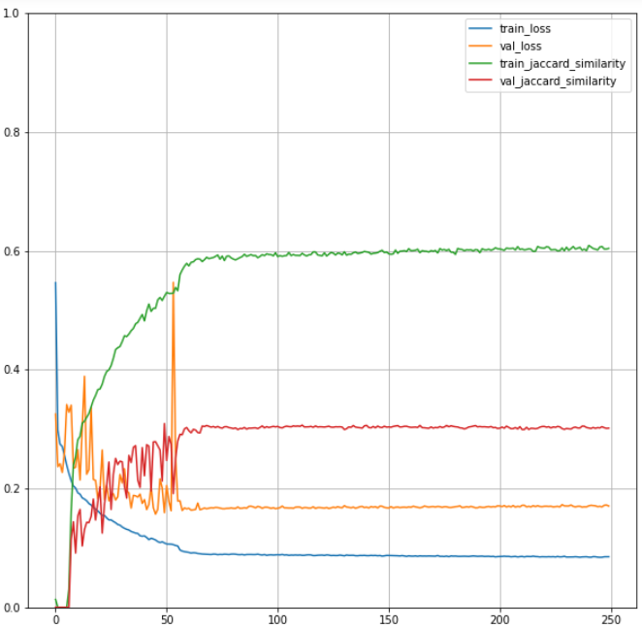
Model training
Building and Man made structures
Roads and dirt tracks

Slide 12
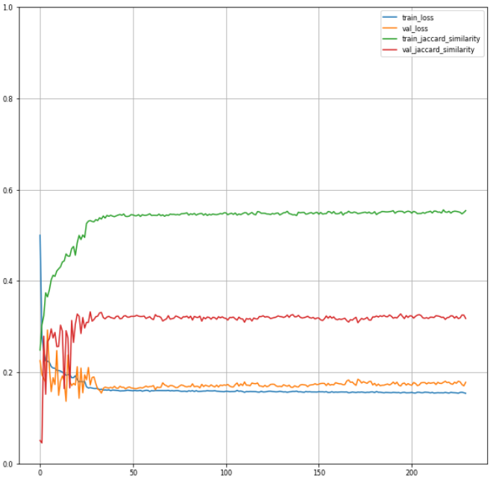
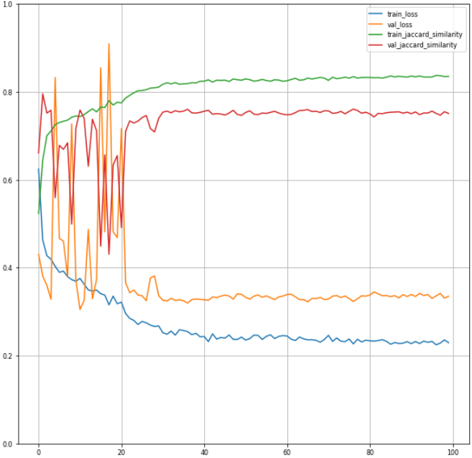
Model training
Trees
Crops

Slide 13
Jaccard Similarity

Slide 14
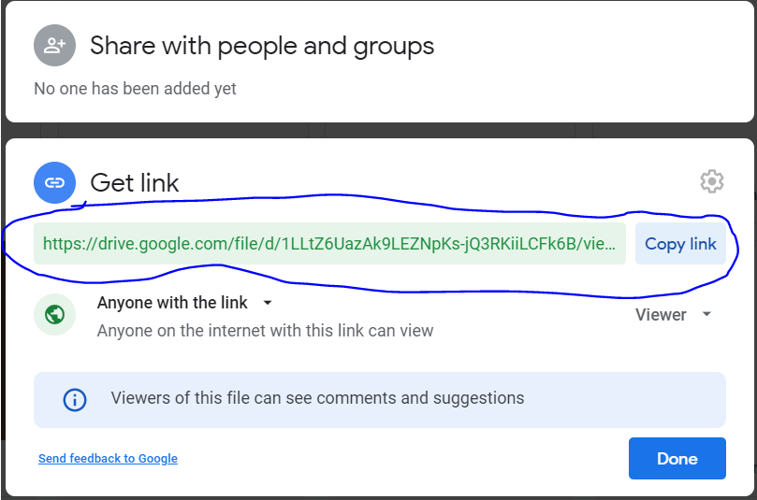
output
To get output 1st upload 2 images in your google drive and get a sharable link as follows.
Extract the image ID from the link.
Example: if your link is https://drive.google.com/file/d/1LLtZ6UazAk9LEZNpKs-jQ3RKiiLCFk6B/view?usp=sharing
then you id will be 1LLtZ6UazAk9LEZNpKs-jQ3RKiiLCFk6B
Create a link as follows:
http:// <Flask url>/predict?imageone= <1st image1D>+imagetwo= <2nd image ID>
The output mask for both the images will be in base64 format. Convert it to image file.

Slide 15
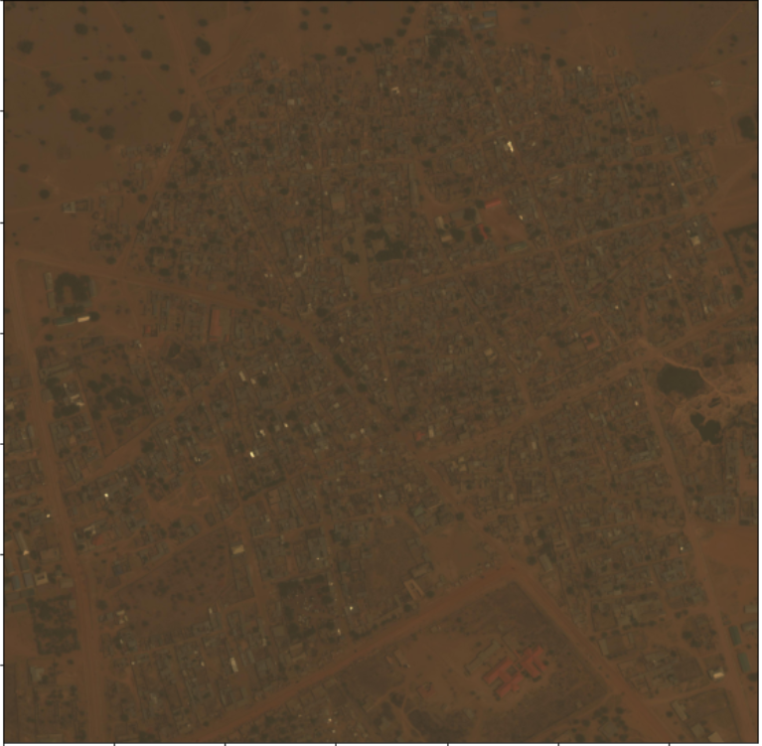
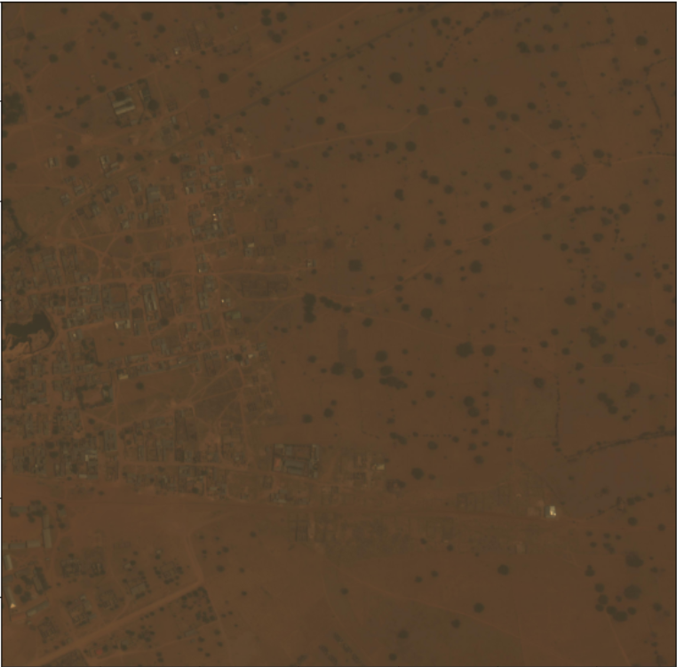
Original Images to be compared
Image -1
Image -2

Slide 16
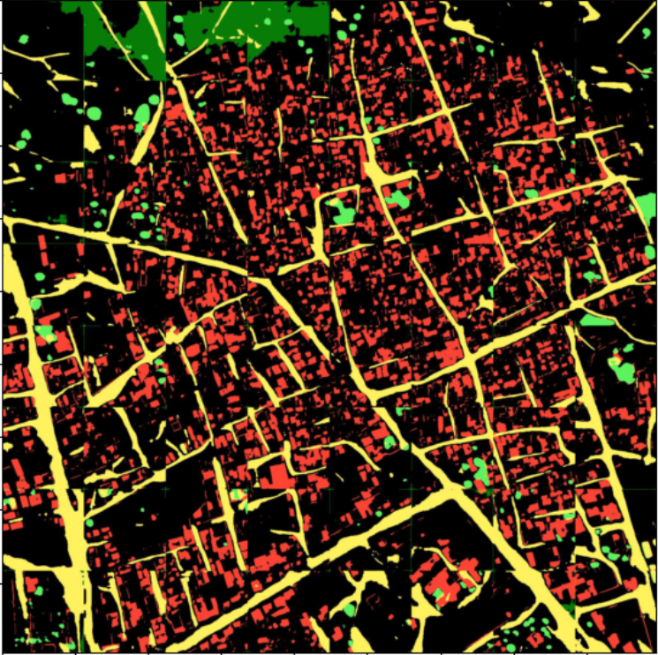
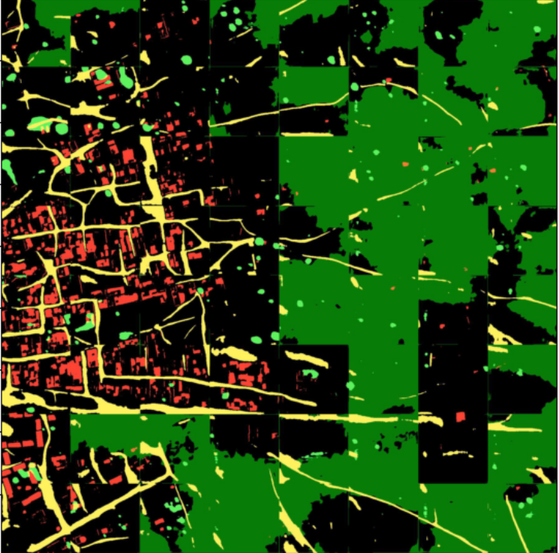
Predicted Images
Image -1
Image -2

